Slide 1
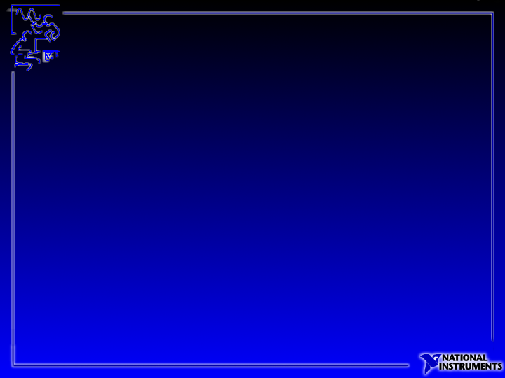
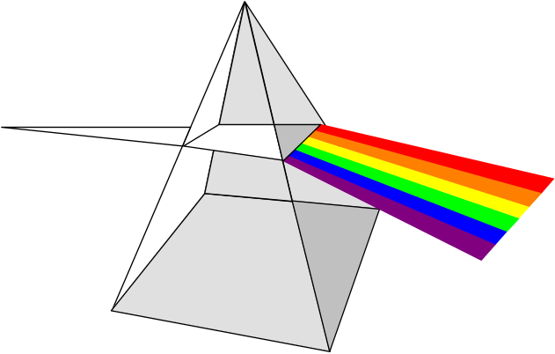
Lesson 10
Processing Color Images
You will learn:
About color representations and color space models
About color byte encoding
How to equalize color images
How to threshold a color image
About color machine vision applications
Notes:
Color is a powerful descriptor that can often simplify object identification and extraction from a scene. Overall, color machine vision is an important tool in a large class of assembly and packaging inspection applications. Inspection involves the verifying that the right components are present in the right location. In many of these applications, the relative colors of these components are used as a basis for inspection.
Color is also widely used in the automotive industry to verify the presence of correct components in automotive assemblies. Components in these assemblies are very often multicolored. Examples range from inspecting fuses in junction boxes to interior fabrics. In this automobile junction box inspection above, the requirement is to verify that all the color-coded fuses have been inserted in the correct orientation.
Color is also used to inspect printed circuit boards containing a variety of components including diodes, resistors, integrated circuits, and capacitors. These components are usually inserted using automatic equipment. The requirement of the vision system is to verify that all components are actually in place, and that all the components are in the correct orientation. In all these applications, traditional approaches using monochrome image information can present problems. More often than not, color capabilities are better suited for machine vision applications where color is the unique identifier for the device under inspection; otherwise color can provide more information than is necessary.

Slide 2
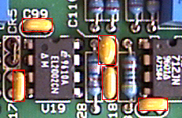
Color Processing
Color quantification
Color matching
Color filtering
Inspection
Electronic Component Inspection

Slide 3
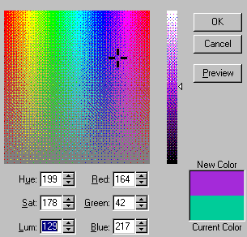
Color Terms
Brightness or luminance is color intensity
Hue is the color (the rainbow)
Saturation is the amount of white light

Slide 4
View HIS Color Plane in PowerPoint
Go to PowerPoint Edit Mode
Double click on this object
Select the more colors option
Select the custom color option
Show how the Hue, Intensity, and Saturation values change
How do you identify two similar colors?
Notes:
How do you identify two similar colors?
Using the HIS model you can histograph and threshold in all three planes to identify two colors that are similar such as blue and light blue?

Slide 5
Color Models
Color model or color space is a way to represent color typically with a 3D-model
Models
  RGB, CMY, HSI

Slide 6
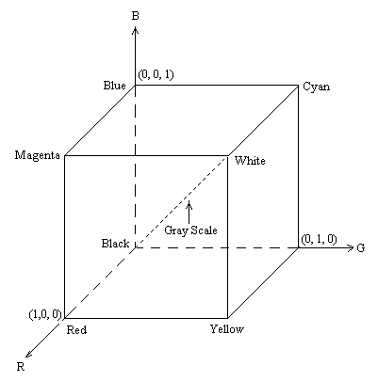
RGB Color Model
Many RGB cameras
Add RGB components
Works similar to human eye
Easy-to-understand
CMY compliment
Green

Slide 7
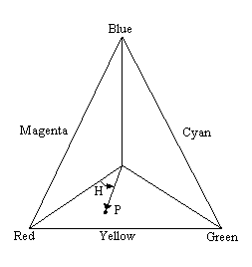
HSI Model
Hue, Saturation, Intensity (HSI)
  Easy for humans to visualize
  Hue is the color (picture a rainbow)
  Intensity is the amount of white in the image

Slide 8
Color Byte Encoding
byte 0 1 2 3
alpha channel
red channel
green channel
blue channel

Slide 9


Color Histograph
Outputs histogram for each plane
IMAQ ColorHistograph.vi

Slide 10

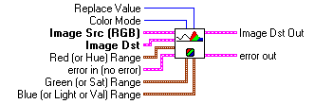
Color Threshold
Threshold 3 planes
  Red, Green, and Blue
  Hue, Saturation, Intensity
IMAQ ColorThreshold.vi

Slide 11
Exercises
Exercise 10-1 - Equalizing a color image
Exercise 10-2 - Thresholding a color image
Exercise 10-3 - Identifying components by color

Slide 12
Lesson 11
Matching Patterns and Shapes
You will learn:
About binary shape matching
About grayscale pattern matching
About applications of pattern matching
About good template sources
How to develop a template image
How to match a template in an image
How to use binary shape matching

Slide 13




Pattern Matching
The Key to Machine Vision
Normalized gray scale correlation
Locate the position and orientation of a known object “fiducial”
Applications
  Alignment
  Inspection
  Gauging
Notes:
Pattern matching provides you with information about the presence or absence, number, and location of the model within an image. For example, you can search an image containing a printed circuit board for one or more alignment marks called fiducials. The positions of the marks are used to align the board for placement of the chips from a chip mounting device. In addition, pattern matching can be used to locate key components in gauging applications. In gauging applications key components are located and then the distance or angle between these objects is “gauged.” If the measurement falls within a tolerance range the part is good, if it falls outside the tolerance the component is rejected. In many applications searching and finding a feature is the key processing task that determines the success of the application.
Alignment: Determine the position and orientation of a known object by locating features. The features are used as points of reference on the object.
Inspection Detect simple flaws, such as missing parts or unreadable printing.
Gauging: Measure lengths, diameters, angles, and other critical dimensions. If the measurements fall outside of set tolerance levels then the component is rejected. Gauging sometimes is used in-line with the manufacturing process and off-line. If the measurements are made off-line. A sample of components is used to determine the quality of a sample or batch of manufactured components.

Slide 14
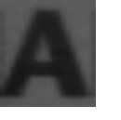


Grayscale Pattern Matching
Template
or Model
Finds location of feature
Easy to understand and implement
Orientation and size limits

Slide 15
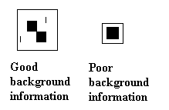

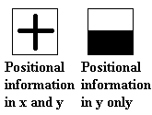
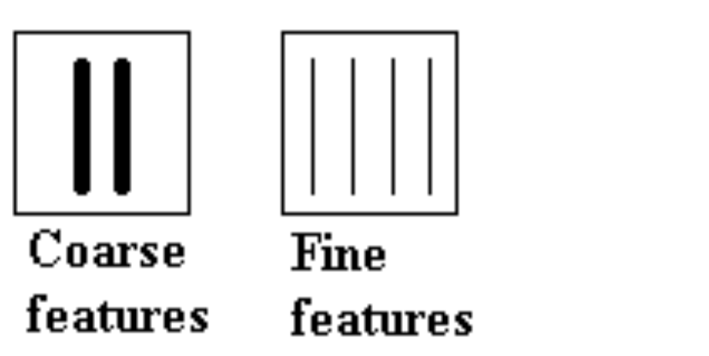
Creating a Good Grayscale Model
Symmetrical asymmetrical

Slide 16
Correlation Basics
Template
Pass template over entire image similar to a filter
Computationally intensive
Smaller templates are faster (less computations)
Features to find

Slide 17


Pattern Matching with
Normalized Gray Scale Correlation
Original Image
Correlation Image
Correlate
Template
Maximum
Correlation
Feature
Draw ROI
Threshold

Slide 18
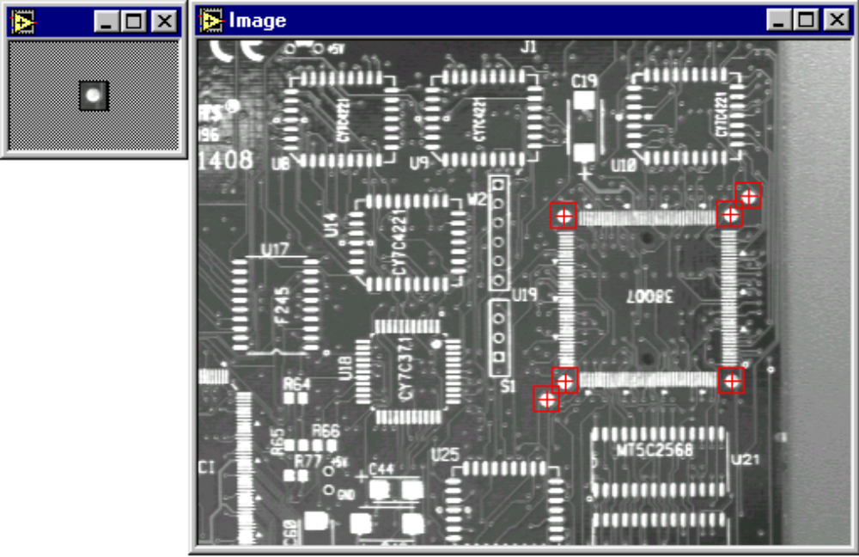
Finding Fiducials

Slide 19

Binary Shape Matching
Finds feature
Uses shape “distance” measurements
Independent of orientation and size
Faster than gray scale pattern machining
Model

Slide 20


Methods for Finding Features
Object is of known size and orientation
  Gray scale pattern matching
  Edge detection and offset
Object is of unknown size
  Blob analysis
  Binary shape matching
Notes:
The method you select for searching depends on the application. If you are searching for a gray scale object where the size of the object is known and the orientation does not deviate by more than 10 degrees then IMAQ Vision gray scale correlation functions will accurately locate the match. Gray scale pattern matching is often used in semiconductor and electronics applications. Typically the search area is a small region within the image. A small search region improves performance.
Edge detection and offset is a common technique if the orientation of the part may vary. You use edges of the part to offset or triangulate to inspect a location. This technique is used in the floppy disk inspection application.
If the object is of varying or unknown size, then you can use blob analysis to find the center of mass of the particle. You must be able to effectively threshold the object to create a binary image with this application. Also, you can use the IMAQ Vision binary shape matching functions to locate objects of varying orientations and size. This function uses a binary model of the object for comparison. An input to this function is a tolerance level that can be adjusted to filter objects of varying shapes.

Slide 21
Exercises
Exercise 11-1 - Creating a template image
Exercise 11-2 - Searching for a pattern in an image
Exercise 11-3 - Searching for a shape in an image

Slide 22
Lesson 12
Using Gauging in Machine Vision Applications
You will learn:
Nine steps for machine vision success
About common inspection techniques
How edges are described
How to use gauging techniques to measure tolerances
How to inspect for missing parts
How to create an alignment application
About identification applications

Slide 23
Nine Steps to Machine Vision Success
1. Identify defects
2. Calculate FOV
3. Select lighting for maximum contrast
4. Calibrate the lighting and camera system
5. Correct for lighting defects
6. Identify fiducials
7. Locate defect features
8. Test the inspection system
9. Automate

Slide 24
Common Inspection Applications
Gauging and caliper
  Measure critical dimensions and compare to tolerances
Inspection
  Part present/not present
Alignment
  Find the position and orientation of an object by locating features
Identification
  Read bar codes, seven segment displays, etc.

Slide 25

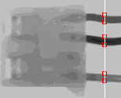
Edge Detection
Find angle of cap
Gauging applications
  Precise measurement of distances between edges
  Defects on edges
  Angles
Inspection applications
  Find cracks
  Parallel solder
  Connectors
Benefits
  Fast (only processing pixels along line profile)
Inspect connector

Slide 26

Edge Tool Parameters
Contrast - minimum difference between the average pixel intensity before and after edge
Width - number of pixels that are averaged to find the contrast at either side of the edge
Steepness - minimum number of pixels that correspond to the transition area of the edge
Contrast
Edge located
Pixels
Width
Steepness
Width

Slide 27
Subpixel Accuracy
Interpolation between pixels
Quadratic or cubic
Line Profile
Edge located
Pixels
Interpolates edge location between pixels

Slide 28



Caliper and Gauging VIs
    Edge Tool - locates edges
Caliper Tool - Finds and measures distance between edge pairs
Line Gauge Tool - measures distance between edge pairs or between edges and points
Rotation detect - measures rotation between differences between two images

Slide 29
Alignment Using Edge Detection and Offset
Origin of local coordinate system
3 points define orientation
Why 3 points?
Benefits
  Fast
Limitations
  Part edges must intersect with line profiles
2 points are
ambiguous
Device under inspection

Slide 30
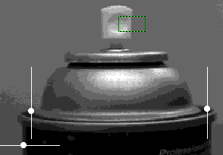
Alignment Using Edge Detection and Offset
3 edges create a local coordinate system
Offset to inspect angle of cap using edge detection

Slide 31
Spray Tip Slope
Calculate slope using pixel coordinates x,y
Scrap cans with slope outside of tolerance
Edge detection

Slide 32
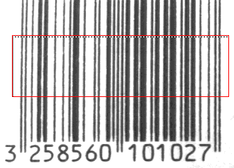
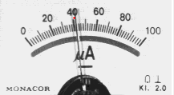
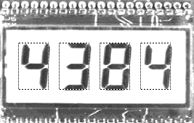
Identification
Bar codes
Gauge and meter inspection
LCD inspection

Slide 33
Exercises
Exercise 12-1 - Using gauging to inspect an aerosol can
Exercise 12-2 - Inspecting an mechanical assembly
Exercise 12-3 - Doing floppy disk inspection

Slide 34
Lesson 13
Processing Images in the Frequency Domain
You will learn:
About frequency processing
How to interpret a frequency domain image
How to filter images in the frequency domain
How to use the 2D FFT function to remove high frequency noise from an image

Slide 35
Frequency Processing
2D Fast Fourier Transform (FFT)
x
u
(0,0)
(0,N-1)
(0,0)
(0,N-1)
Image
Frequency
Image
2D FFT
y
v
(0,M-1)
(0,M-1)
Spatial Domain
Frequency Domain

Slide 36
2D FFT
Done in two steps
    1D FFT of each row in the image, followed by
    1D FFT of each column.
1D FFT
Image
1D FFT
Frequency Image

Slide 37
Interpreting Frequencies
Two frequencies - horizontal and vertical
Frequency values range from 0 to N/2 where N is the width or height of the image.
For example, if the image size is 256 x 512
  maximum horizontal frequency = 128 cycles/image
  maximum vertical frequency = 256 cycles/image

Slide 38
Unordered Vs Ordered
Unordered Image (after IMAQ FFT)
Ordered Image (IMAQ WinDraw)
(-N/2, -M/2)
(-N/2, M/2)
Low
frequencies
Low
frequencies
High
frequencies
High
frequencies
High
frequencies
Low
frequencies
Low
frequencies
Low
frequencies
High
frequencies
High
frequencies
(N/2, -M/2)
(N/2, M/2)

Slide 39

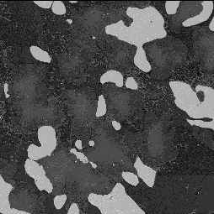


FFT Display
IMAQ FFT
IMAQ WinDraw
Raw Image
Ordered
High
frequencies
High
frequencies
Low
frequencies
Ordered Image
High
frequencies
High
frequencies
Notes:
High frequencies are grouped at the center while low frequencies are located at the edges.

Slide 40
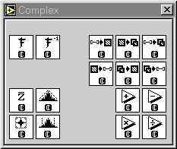
IMAQ Vision Complex Functions
FFT
Inverse FFT
Math operators
Complex Truncate

Slide 41
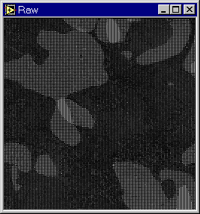
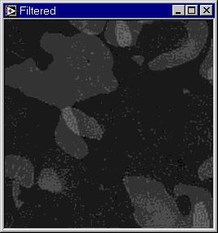
Exercises
Exercise 13-1 - Doing an FFT of an image
Exercise 13-2 - Find repeating noise and remove it from an image
Notes:
In the example above, 60 Hz noise has leaked into the image. We used the IMAQ Vision 2D FFT function to determine the frequency range of the noise. Once the frequency range was determined, a low pass filter was applied to remove the noise. The inverse 2D FFT shows the image with the noise removed. This example is part of the IMAQ Vision demo. Complex functions such as 2D FFT are a part of the Advanced IMAQ Vision software.

